Slide 1



KS3 Mathematics
S6 Drawing lines and angles
Notes:
The aim of this unit is to teach pupils to:
Construct lines, angles and shapes
Find simple loci, both by reasoning and by using ICT
Material in this unit is linked to the Key Stage 3 Framework supplement of examples pp 220-227.

Slide 2
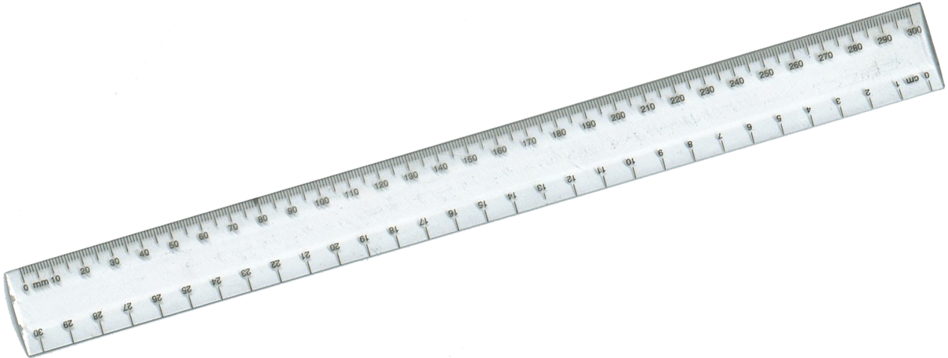
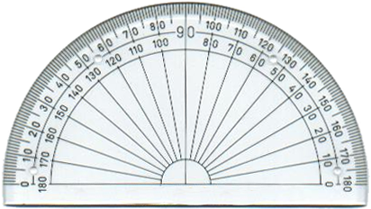
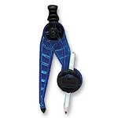



Equipment needed for constructions
Before you begin make sure you have the following equipment:
A ruler marked in cm and mm
A protractor
A sharp pencil
A pair of compasses
Notes:
Constructions should be drawn in pencil and construction lines should not be rubbed out.

Slide 3
Drawing lines
To draw a line of given length use a ruler and a sharp pencil.
For example, draw line segment AB of length 56 mm.
Draw a point and label it A.
Place your ruler with 0 mm at the point A.
Mark point B at 56 mm.
Draw line segment AB.
A
B
0
1
2
3
4
5
6
7

Slide 4
Drawing angles
To draw a given angle use a ruler, a protractor and a sharp pencil.
For example, construct ABC = 68°.
Start by drawing line segment AB.
C
Place a protractor so that point B is at the centre of the small circle.
Reading the scale so that 0° is on the line, mark point C at 68°.
Use a ruler to draw a line from point B to point C.
A
B

Slide 5
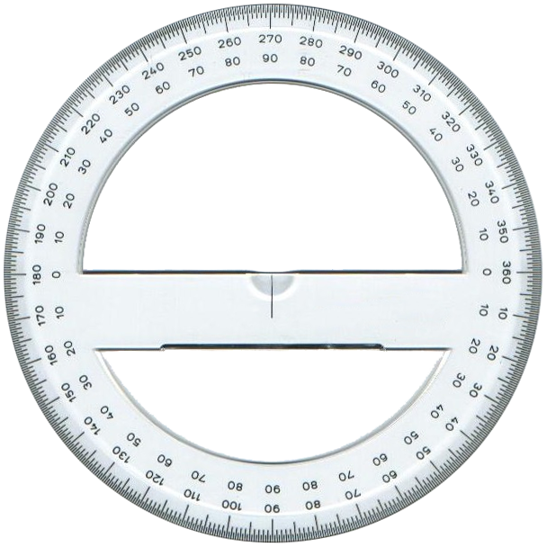
Drawing reflex angles
To draw a reflex angle we can use a 360° protractor.
To draw a reflex angle using a 180° protractor, start by subtracting the angle from 360°.
For example, to draw an angle of 243° work out 360° – 243°.
360° – 243° = 117°.
Draw an angle of 117°.
117°
The reflex angle will be the required 243°.
243°

Slide 6
Drawing lines and angles
Draw the following lines and angles as accurately as possible using a ruler and a protractor.
38 mm
305°
47 mm
4 cm
78°
128°
54 mm
5 cm
62 mm

